Slide 1
Theory and implementation of optimisation methods for optimizations in distribution power system – PART 2
Faculty of Electrical Engineering, Computer Science and
Information Technology Osijek, April 2019, Osijek
Workshop – day 3:
Marinko Barukčić, PhD.
Faculty of Electrical Engineering, Computer Science and Information Technology Osijek
JOSIP JURAJ STROSSMAYER UNIVERSITY OF OSIJEK

Slide 2
PART 2: optimization by simulation tools
Faculty of Electrical Engineering, Computer Science and
Information Technology Osijek, April 2019, Osijek
Workshop working simulation tools: OpenDSS
Optimization problem – analytic OF
Exercise 1:
Find optimal powers of the generating units such that power (energy) production cost is as low as possible (unit commitment problem).
System data (T expl.):
4 power sources
total system load

Slide 3
Faculty of Electrical Engineering, Computer Science and
Information Technology Osijek, April 2019, Osijek
PART 2: optimization by simulation tools
Workshop working simulation tools: OpenDSS
Optimization problem – analytic OF
Exercise 1:
Production cost functions:
Total load: 2500 kW
Unit/ Coefficient | 0 | 1 | 2 | 3
a [EUR/kW²] | 3e-4 | 2e-4 | 8e-4 | 1e-4
b [EUR/kW] | 0.02 | 0.015 | 0.024 | 0.018
c [EUR] | 7 | 5 | 4 | 7

Slide 4
PART 2: optimization by simulation tools
Faculty of Electrical Engineering, Computer Science and
Information Technology Osijek, April 2019, Osijek
Workshop working simulation tools: OpenDSS
Specific tasks (T expl.):
Formulate the optimization problem
Coding decision variables in the method individual
Defining ranges (limits) of the decision variables-box constraints
Coding the problem in the specific optimization tool

Slide 5
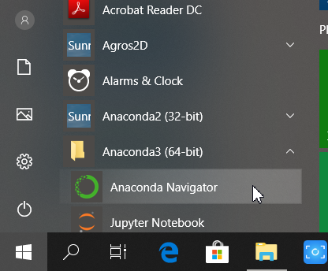
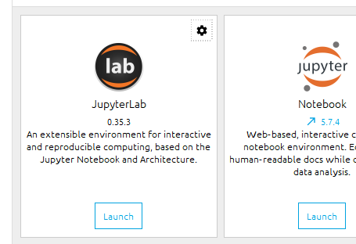
PART 2: optimization by simulation tools
Faculty of Electrical Engineering, Computer Science and
Information Technology Osijek, April 2019, Osijek
Workshop working simulation tools: OpenDSS
Using simulation tool

Slide 6
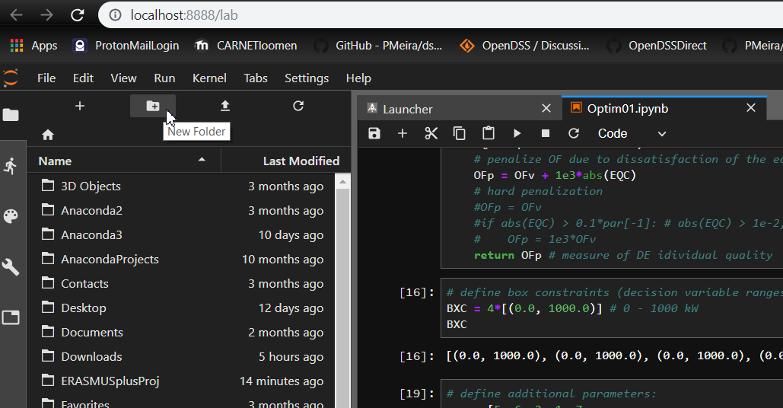
PART 2: optimization by simulation tools
Faculty of Electrical Engineering, Computer Science and
Information Technology Osijek, April 2019, Osijek
Workshop working simulation tools: OpenDSS
Using simulation tool

Slide 7
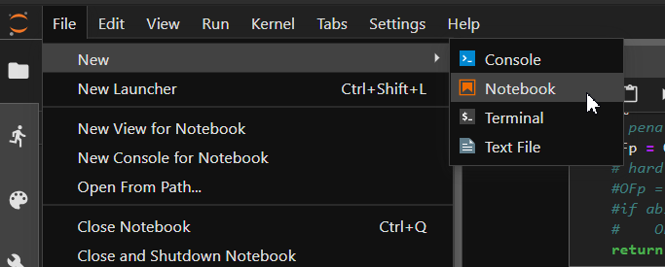
PART 2: optimization by simulation tools
Faculty of Electrical Engineering, Computer Science and
Information Technology Osijek, April 2019, Osijek
Workshop working simulation tools: OpenDSS
Using simulation tool

Slide 8
PART 2: optimization by simulation tools
Faculty of Electrical Engineering, Computer Science and
Information Technology Osijek, April 2019, Osijek
Workshop working simulation tools: OpenDSS
Using simulation tool:
Needed PY packages
DE individual code
Objective function and constraints
DE syntax
View solution

Slide 9
PART 2: optimization by simulation tools
Faculty of Electrical Engineering, Computer Science and
Information Technology Osijek, April 2019, Osijek
Workshop working simulation tools: OpenDSS
OpenDSS (features):
Unbalanced power flow
Models of renewable sources
Models of storage
Interface to other tools via COM (MATLAB, VB for App., Python (recently PY package - https://github.com/dss-extensions/OpenDSSDirect.py )

Slide 10
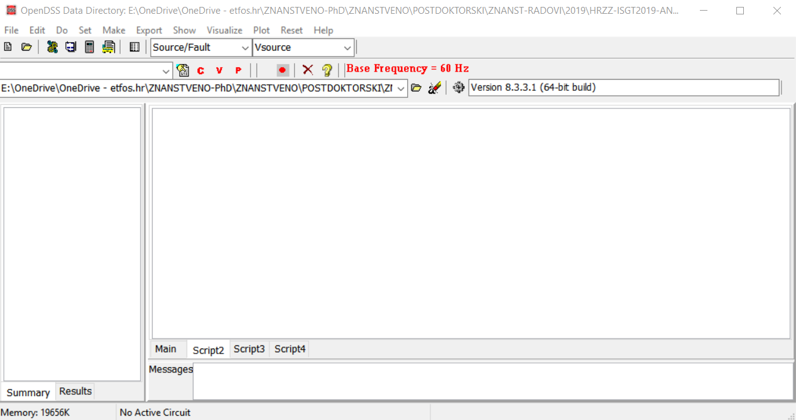
PART 2: optimization by simulation tools
Faculty of Electrical Engineering, Computer Science and
Information Technology Osijek, April 2019, Osijek
Workshop working simulation tools: OpenDSS
OpenDSS script: txt file written in any text editor or built-in user interface.

Slide 11
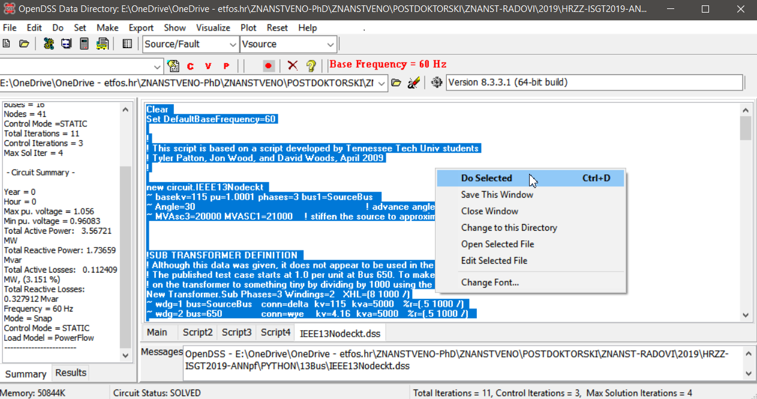
PART 2: optimization by simulation tools
Faculty of Electrical Engineering, Computer Science and
Information Technology Osijek, April 2019, Osijek
Workshop working simulation tools: OpenDSS
OpenDSS script (execute script):
1. Select text, CTRL+A
2. Rigth click + Do selected or menu Do>Selected Line(s) or click on the icon

Slide 12
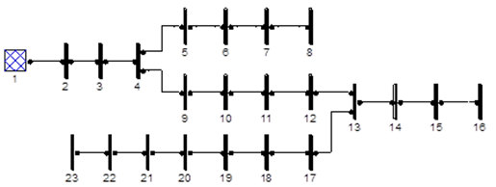
PART 2: optimization by simulation tools
Faculty of Electrical Engineering, Computer Science and
Information Technology Osijek, April 2019, Osijek
Workshop working simulation tools: OpenDSS
OpenDSS script:
New circuit.SomeName basekv=115 pu=1.0 phases=3
~ bus1=SourceBus Angle=30
~ MVAsc3=20000 MVASC1=21000
Set DefaultBaseFrequency=50
New element.name Bus1=Name Par1=value Par2=value …
Command verb Object (class) – network element

Slide 13
PART 2: optimization by simulation tools
Faculty of Electrical Engineering, Computer Science and
Information Technology Osijek, April 2019, Osijek
Making OpenDSS script - Example
Exercise 2:

Slide 14
PART 2: optimization by simulation tools
Faculty of Electrical Engineering, Computer Science and
Information Technology Osijek, April 2019, Osijek
Making OpenDSS script - Example
Exercise 2:
Start
clear
External network (slack node)
New circuit.TestNet basekv=11 pu=1.0 phases=3 bus1=SourceBus Angle=0
Lines
New line.L1 bus1=SourceBus bus2=B2 R1=0.117 X1=0.048 Phases=3

Slide 15
PART 2: optimization by simulation tools
Faculty of Electrical Engineering, Computer Science and
Information Technology Osijek, April 2019, Osijek
Making OpenDSS script - Example
Exercise 2:
Loads
New load.LD1 bus1=B2 kv=11 kw=230 kvar=142.5 model=1 Phases=3 conn=wye
Voltages for p.u.
Set voltagebases=[11]
Bus list construction
Calcv

Slide 16
PART 2: optimization by simulation tools
Faculty of Electrical Engineering, Computer Science and
Information Technology Osijek, April 2019, Osijek
Making OpenDSS script - Example
Exercise 2:
Power flow calculation
Solve
Show some results
Show voltages
Save DSS script under some filename.
Brief overview of OpenDSS scripting:
https://sourceforge.net/p/electricdss/code/HEAD/tree/trunk/Distrib/Doc/OpenDSS%20Cheatsheet.pdf

Slide 17
PART 2: optimization by simulation tools
Faculty of Electrical Engineering, Computer Science and
Information Technology Osijek, April 2019, Osijek
Faculty of Electrical Engineering, Computer Science and
Information Technology Osijek, April 2019, Osijek
Coffee break – 15 min
2019-03-30
17

