Slide 1
MoER Topic: IMRaD approach to writing scientific papers part 3: Results
Zekić-Sušac Marijana

Slide 2
What will you learn here?
Why do you need this section of your research paper?
What should this section describe?
How to use tables and figures to describe results?
Some examples of good description of results

Slide 3
Why are results important?
Results section should contain findings and outcomes of your research. It should provide arguments for answering your research questions.
It is the central part i.e. core of paper, should be the longest part of paper (approx. 35% of the paper) – recall the IMRaD pillar!
Describes what the methods revealed (this section deals with facts, not subjective oppinions)
According to (Carnegie Mellon University, 2017), there two main parts of the Results section:
Reporting results – tables, figures, textual explanation
Commenting results – partially here, partially in Discussion section

Slide 4
What should this section describe
Report the results in the form of text, tables, and figures
An issue: how much the information in the text should overlap with that in the tables and figures?
Advice: textually refer to every table and figure in the paper, and describe the most important numbers or other indicators shown in tables and figures
Example on how to refer to a table:
„Table II shows the results of the analysis of growth aspirations – employment: a mean percentage of early stage entrepreneurs regarding their plans on the future number of jobs for each of the three countries, as well as results on the significance of differences among countries. „ (Tominc, Rebernik, 2007)

Slide 5
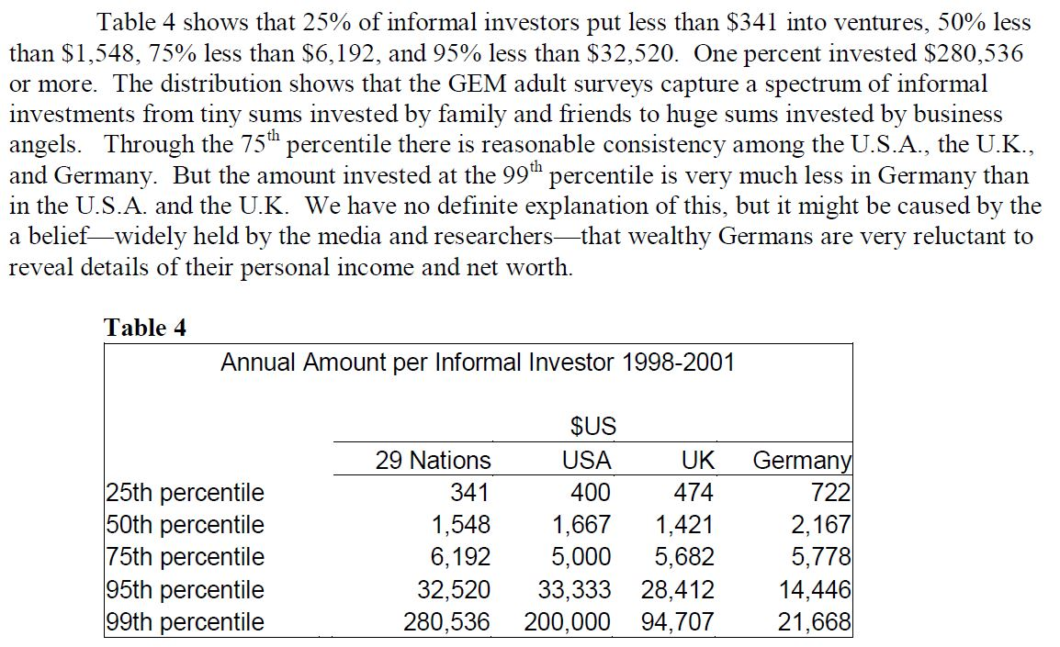
How to use tables
(Bygrave et al., 2007)

Slide 6
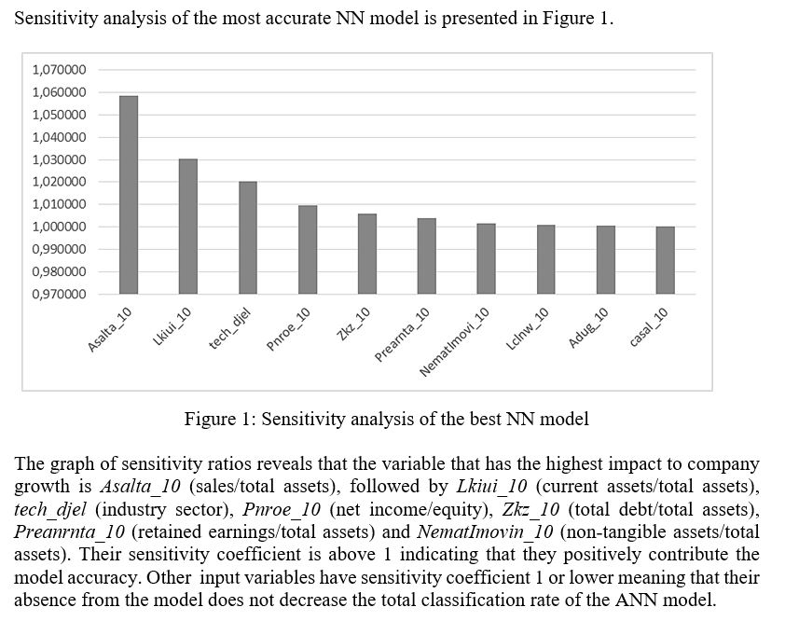
How to use figures
(Zekić-Sušac et al., 2017)

Slide 7
Achieving the validity of results
When you investigate relationships among variables, instead of reporting one result, give comparison if possible (with a benchmark or with another research)
For example: Is the relationship between two variables that you have examined also confirmed in previous research or not?
When you do modeling by testing a method, compare it to another method, and use statistical tests of differences in results
When you do modeling, test your methods on more samples, not just on one sample, in order to obtain generalization validity of results

Slide 8
Some tips
Make sure to comment every table and figure in the paper.
Take care of the format of tables and figures given in a journal template.
Give a number and a title to every table and figure.
If a table is too long, put it in Appendix.
Do not comment wider implications and conclusions that could be drawn from the results here – it goes to Discussion section.
Percentages say more than raw numbers.
If comparing two or more methods or models, give some statistical tests of comparison (p-values or other)
In case of modelling, provide some measures of model fitting (How the model fits the data? F-test, or other appropriate tests)

Slide 9
Other good examples
See how other researchers described their results
Make sure to cover all major findings in your Results, and use tables and figures to make it more illustrative.
Avoid describing your subjective oppinion which cannot be argumented by your results.
For other examples of Results section, see additional readings in this lesson.
REMEMBER: The Results section is something that you have discovered, and you should be proud of!

Slide 10
References:
Caprette, D.R., Writing Research Paper, Rice University, http://www.ruf.rice.edu/~bioslabs/tools/report/reportform.html, Nov 10, 2011.
Carnegie Mellon University, Global Communication Center, IMRD Cheet Sheet, https://www.cmu.edu/gcc/handouts/IMRD%20with%20Examples.pdf, [accessed 10.01.2017] Cornell University Library, Library PSEC Documentation Committee, http://www.library.cornell.edu/resrch/citmanage/apa, revised April 2011, 13.11.2013.
Educational Research, Designing the Research, https://www.nfer.ac.uk/schools/developing-young-researchers/how-to-choose-your-research-methods/ , [accessed: 10.01.2017]
Gillet, A., Using English for Academic Purposes, UEFAP.com, http://www.uefap.com/writing/writfram.htm, Nov 15, 2011.
Purdue University, Purdue Online Writing Lab, https://owl.english.purdue.edu/owl/ , Nov 13, 2013
RefernCite, Academic Referencing Resource, http://www.cite.auckland.ac.nz/index.php?p=which_referencing_style , 13.11.2013.
Science Buddies, Writing a Research Paper for Your Science Fair Project, http://www.sciencebuddies.org/science-fair-projects/project_research_paper.shtml, Nov 11, 2011.
Study Habits, Essay Writing – IMRAD Format – Explanation, http://www.study-habits.com/imrad-format-explanation, [accessed: 10.01.2017]
Swales, J.M., Feak, C. B., Academic Writing for Graduate Students, The University of Michigan Press, Ann Arbor, 1996.
Tominc, P., Rebernik, M., Growth Aspirations and Cultural Support for Entrepreneurship: A Comparison of Post-Socialist Countries, Small Business Economics, Vol. 28 (2007), pp. 239–255.
Zekić-Sušac, M. Pfeifer, S., Šarlija, N., A Comparison of Machine Learning Methods in a High-Dimensional Classification Problem, Business Systems Research, Vol. 5 No. 3, 2014, pp. 82-96.
Zekić-Sušac, M., Šarlija N., Benšić, M., Small Business Credit Scoring: A Comparison of Logistic Regression, Neural Network, and Decision Tree Models, Interfaces ITI 2004, V. Hljuz-Dobric, V. Luzar-Stiffler (eds.), June 7-10, 2004., Cavtat, Croatia, pp. 265-270.
Zekić-Sušac, M., Šarlija, N., Has, A., Bilandžić, A., Predicting company growth using logistic regression and neural networks, Croatian Operational Research Review, Volume 7, Number 2, 2016, pp. 229-248.
Woolf, L. M., Research Methods, http://faculty.webster.edu/woolflm/statistics.html, Webster University, [accessed 10.01.2017]

