Slide 1
Svojstva trigonometrijskih omjera u pravokutnom trokutu
Lidija Blagojević, prof.

Slide 2
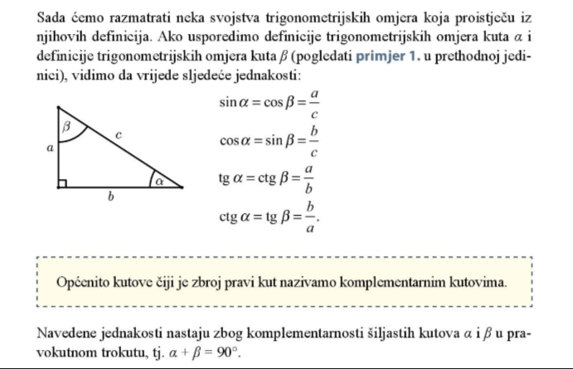
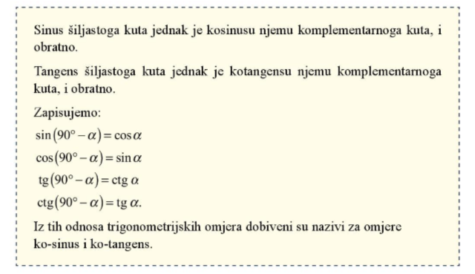

Slide 3
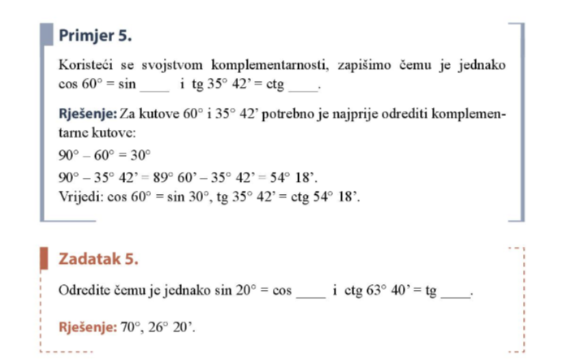

Slide 4
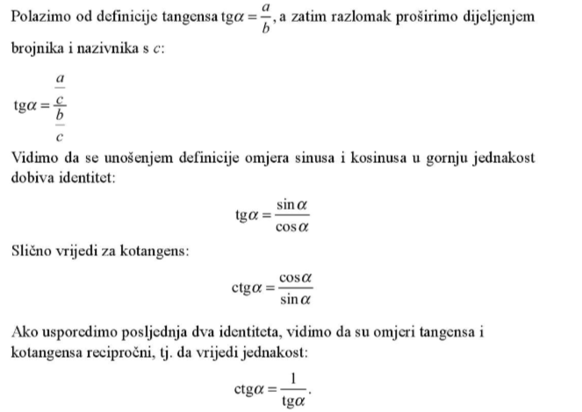
Osnovni trigonometrijski identitet

Slide 5
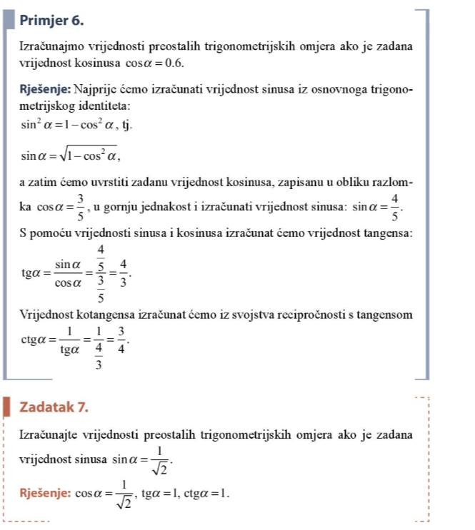
$$cosα=0.6=\frac{6}{10}=\frac{3}{5}$$
$$sinα=\sqrt[2]{\begin{aligned}1−{\left(\frac{3}{5}\right)}^{2} \\ \end{aligned}}$$
$$sinα=\sqrt{\frac{16}{25}}=\frac{4}{5}$$
$$cosα=\sqrt{1−\sin^{2}α}$$
$$cosα=\sqrt{1−\frac{1}{2}}$$

Slide 6
Zadaci, str. 144
Rješenje:
b) cos 42°40’ = sin (90°-42°40’) = sin (42°20’)
Ostali za DZ

Slide 7
Rješenje:
b) $sinα=0.5 \sin^{2}α+\cos^{2}α=1 \cos^{2}α=1−\sin^{2}α$ pa je$\cos^{2}α=1−0.25 odnosno\cos^{2}α=0.75 te korjenovanjem dobijemo cosα=0.866025$
$$tgα=\frac{sinα}{cosα}=\frac{0.5}{0.866025}=0.57735$$
$$ctgα=\frac{1}{tgα}=\frac{1}{0.57735}=1.73205$$
e) $tgα=1\frac{1}{3}=\frac{4}{3}$ pa je $ctgα=\frac{3}{4}$
$\sin^{2}α+\cos^{2}α=1$ / $\cos^{2}α$
$\frac{\sin^{2}α}{\cos^{2}α}+$ $\frac{\cos^{2}α}{\cos^{2}α}$= $\frac{1}{\cos^{2}α}$
${tg}^{2}α+1=$ $\frac{1}{\cos^{2}α}$
DZ sve ostale
$${\text{(}\frac{4}{3})}^{2}+1=\frac{1}{\cos^{2}α}$$
$$\frac{25}{9}=\frac{1}{\cos^{2}α}$$
$$\cos^{2}α=\frac{9}{25} pa je cosα=\sqrt{\frac{9}{25}}=\frac{3}{5}$$
$$\sin^{2}α=1−\cos^{2}α$$
$\sin^{2}α=1−$ $\frac{9}{25}=\frac{16}{25} pa je sinα=\sqrt{\frac{16}{25}}=\frac{4}{5}$

Slide 8
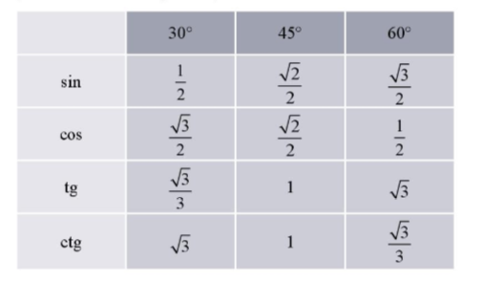

Slide 9
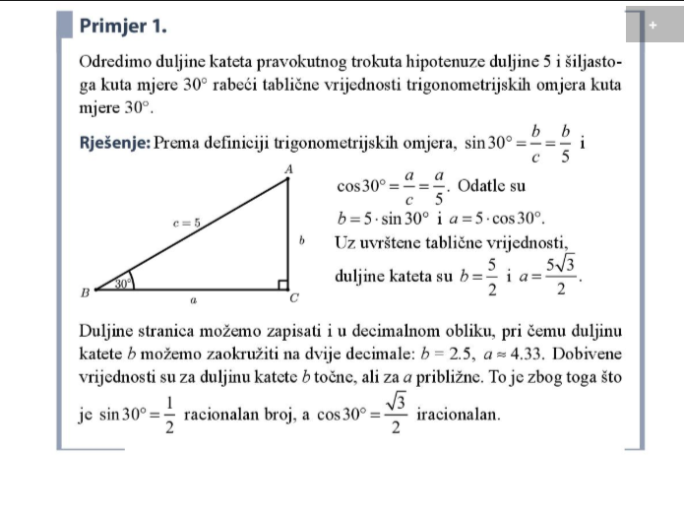
$$\frac{1}{2}=\frac{b}{5}$$
2b=5/2

Slide 11
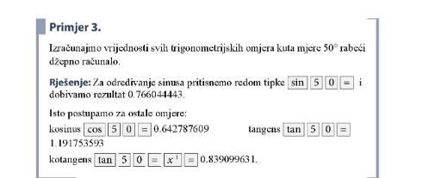

Slide 12
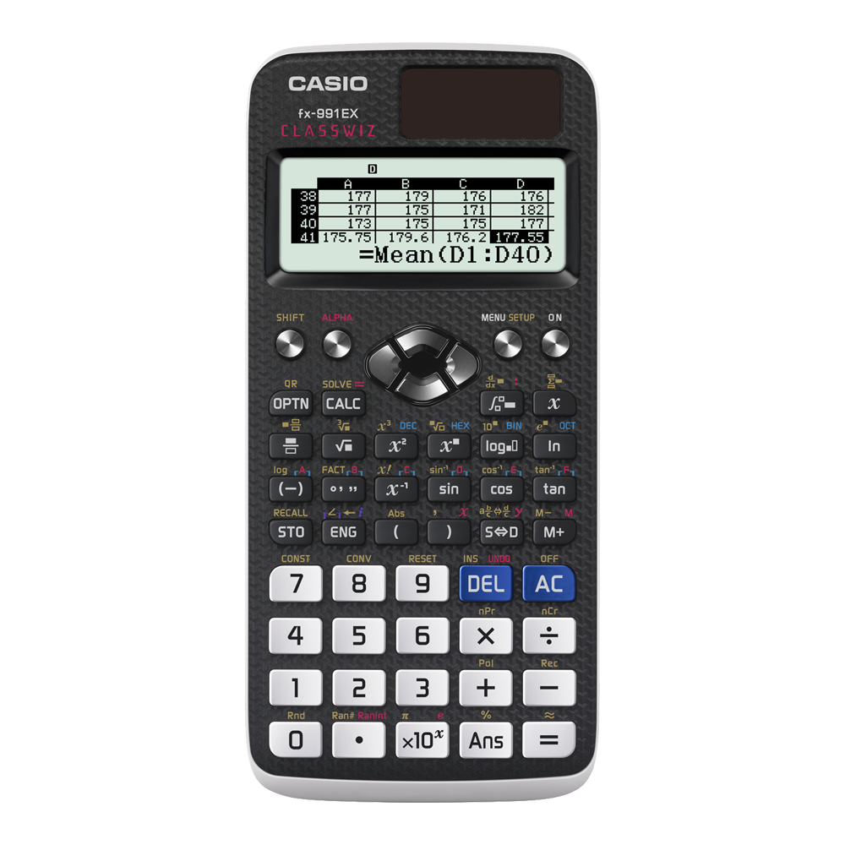

Slide 13
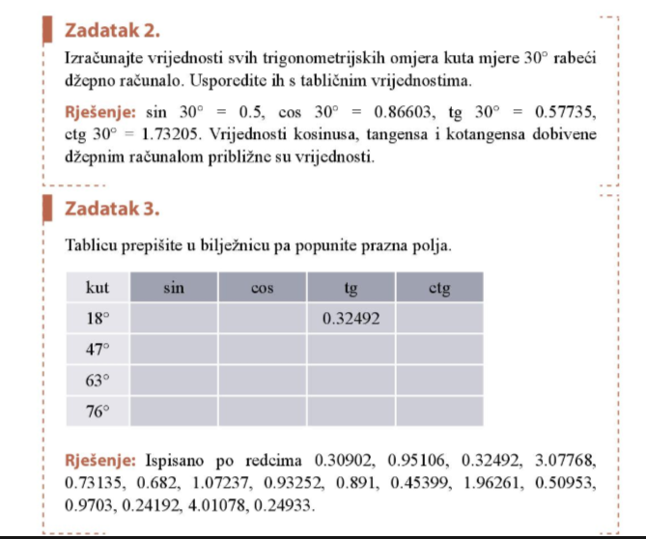
DZ

